Slide 1
Goodreads Reviews Analysis
Mobolaji Shobanke - Martin Banghart

Slide 2
Project Scope & Objective
Objective:
Explore and Analyse the relationship between Reader’s Reviews and Book Ratings.
Scope:
Extract data for the Top 100 books ranked by Times Magazine from goodreads.com.
Transform and Load Data into GraphDB (Arango).
Identify and Filter Irrelevant/Spam Reviews.
Carry out exploratory analysis on the relationship between reviews and ratings.
Notes:
Marty

Slide 3
Data Extraction
The data was initially scraped in a structured format, specifically in rows and columns, using BeautifulSoup and Selenium via Python.
A selection of the top 100 books ranked by Times Magazine was used as the basis for collection.
User Reviews for the 100 books were then retrieved and from this, further information, such as:
User specific reviews for those flagged as spam (reviews relating to a subset of original 100 books)
Notes:
Marty

Slide 4
Overview of Scraped Data from Goodreads.com
Top 100 Books
unique_id
book_title
book_link
review_page_link
Book Reviews
user_id
display_name
user_href
title
rating
likes
comments
review
date_added
language
Flagged Users Reviews
user_id
review_id
title
author
rating
review
date_added
language
Notes:
Marty

Slide 5
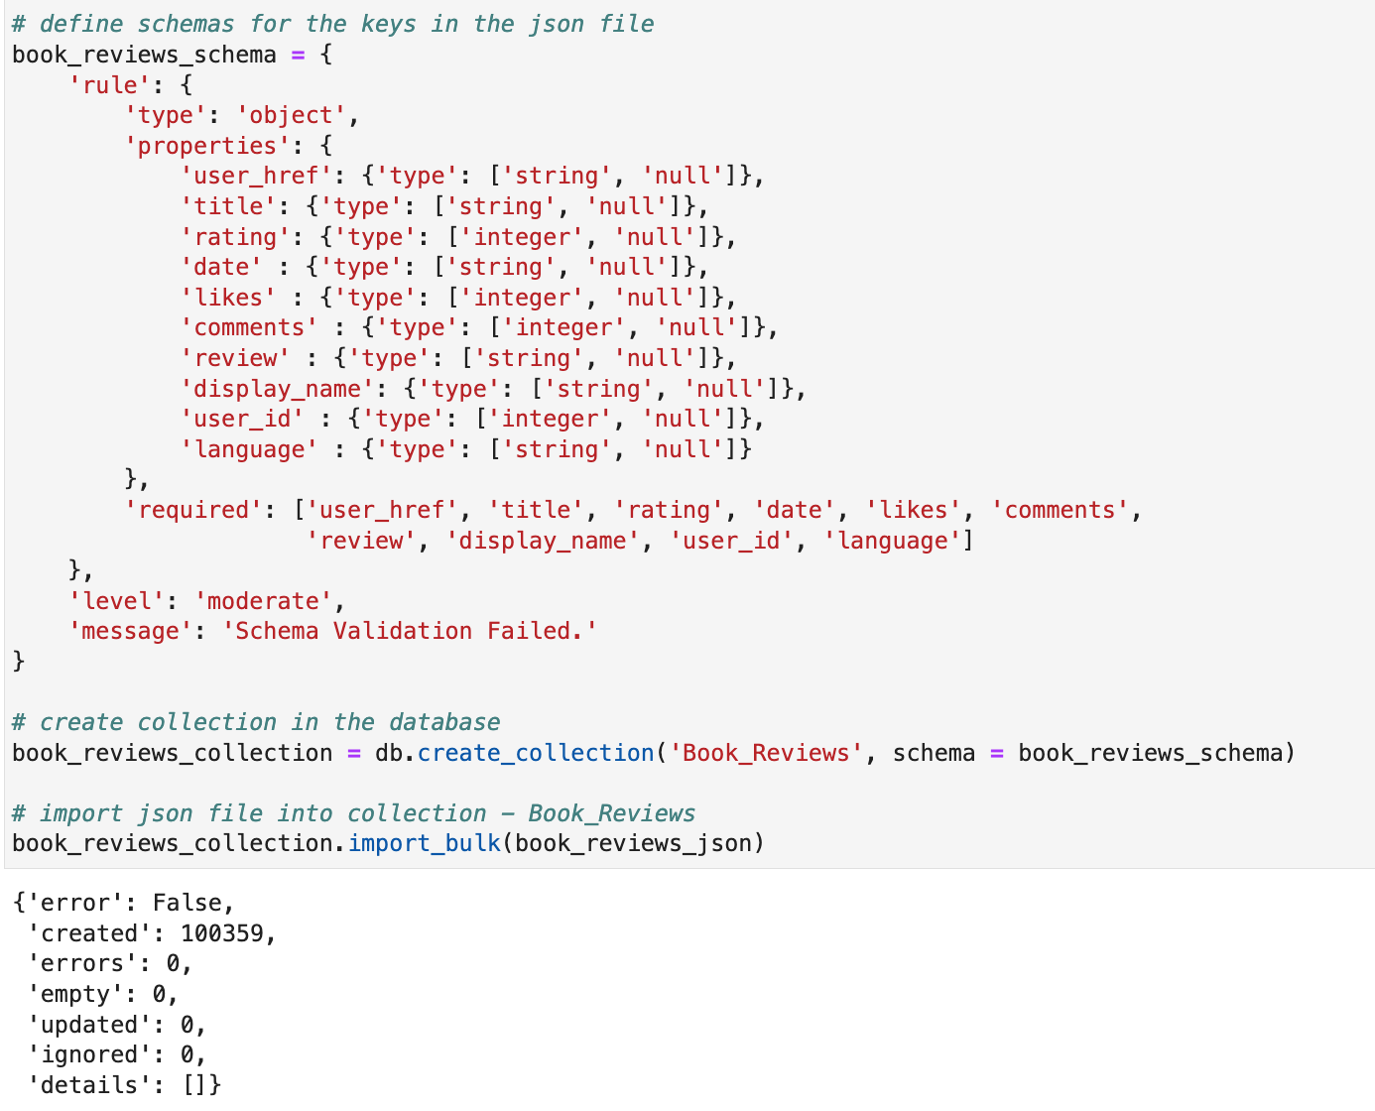
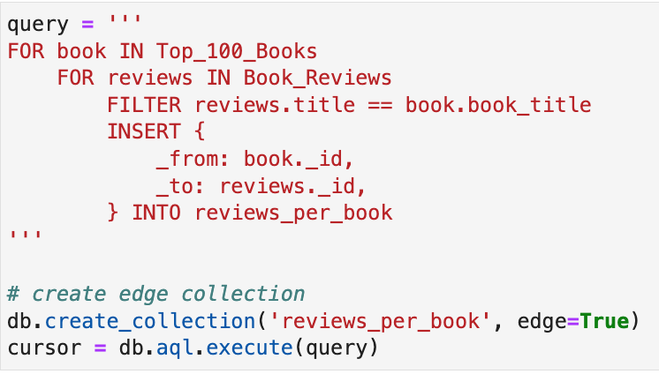
Data Loading
Book_Reviews (Vertex Collection)
reviews_per_book (Edge Collection)
After Data Extraction and Transformation, the data was loaded into Arango in the following format
Notes:
Marty

Slide 6
Database - Overview
ArangoDB was used for creation of a graph database
4 Vertices:
Top_100_Books,
Book_Reviews,
Spam_Reviews,
Flagged_Users_Reviews
3 Edges:
reviews_per_book,
spam_reviews_per_book
spammers_goodreads_reviews
Top 100 Books
Book Reviews
reviews_per_book
spam_reviews_per_book
Spam Reviews
Flagged Users Reviews
spammers_goodreads_reviews
Notes:
Marty

Slide 7
Irrelevant Reviews/Spam Identification
The spam identifier was built using Supervised Machine Learning (SVC). The model for identifying spam was created using a manually labeled sample of 30 reviews (87 non-null data points) from 3 books, namely:
To Kill a Mockingbird
1984
The Lord of the Rings
Requirements for Irrelevant Reviews:
Review says nothing about the book.
Text is incoherent.
Review aims to selfishly divert a reader’s attention away from the book being discussed.

Slide 8
Spam Identification Pipeline
“No, you’re spam”
“Hey there, am I relevant?”
Dimensionality Reduction
PCA (n=59)
text_preprocessing
Vectorization
(Tf-Idf)
Classifier
Language detection
&
Translation
Tokenization
Parts of Speech
Tagging
Lemma Reassembling
&
Return iterable dtype
Punctuation
Removal
Stopwords Removal
Lemmatization

Slide 9
Classifier / Model Build
Training Data
SVC
Model Calibration
Brier Score = 0.18
Supervised learning
Semi_supervised learning
Selftraining Classifier
(SVC)
Best-Model (KFold)
Accuracy_score = 0.94
F1_score = 0.80
Accuracy_score = 0.90
F1_score = 0.73
Random Check
'Head on to my youtube page for more interesting contents! visit my link @ youtube.com/EMSE_6586/best_class'

Slide 10
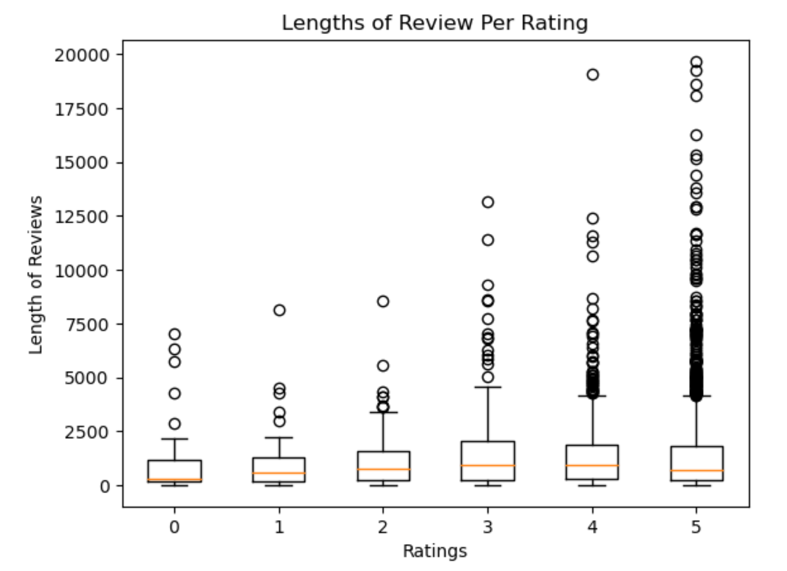
Exploratory Analysis (Reviews vs Rating)
rating | review_count | avg_character_len | min_character_len | max_character_len | total_likes | total_comments
0 | 59 | 970 | 3 | 7025 | 1536 | 211
1 | 69 | 1019 | 4 | 8139 | 3530 | 721
2 | 85 | 1279 | 16 | 8547 | 4328 | 726
3 | 188 | 1612 | 24 | 13192 | 5333 | 878
4 | 765 | 1386 | 4 | 19090 | 21374 | 2392
5 | 2007 | 1428 | 4 | 19672 | 68676 | 7777
Observation
There is only a slight difference in the average length of reviews among the different rating categories.
There is a considerably larger amount of outliers in the length of reviews for ratings of 5, compared to the other rating categories.

Slide 11
Statistical Tests - t_test, correlation, chi-square
According to the results of the two-sample t-test, there is only a statistically significant difference in the average length of reviews between ratings 0 and 3, as well as between ratings 1 and 3.
ratings_compared | p_values (<0.05)
(0, 3) | 0.03
(1, 3) | 0.03
2 sample t_test
Correlation Matrix | ratings | reviews_length
ratings | 1.000000 | 0.031256
review_length | 0.031256 | 1.000000
From the correlation matrix, there is no degree of linear dependence between ratings and length of reviews.
According to Chi-square test for independence between length of reviews and ratings, length of reviews has no impact or influence on book ratings.
Chi-square statistic | p-value
477.251 | 1.0

Slide 12
Keyword Analysis - Bigrams & Frequency of Occurrence
bigram | (atticus, finch) |  |  | (george,orwell) |  | (hate,hate) | (lord,ring) |  |  |  |  | (read, book)
rating | 1 | 4 | 5 | 4 | 5 | 1 | 0 | 2 | 3 | 4 | 5 | 0 | 1 | 2 | 3 | 4 | 5
frequency | 8 | 67 | 211 | 82 | 161 | 119 | 13 | 14 | 29 | 105 | 493 | 9 | 16 | 7 | 55 | 141 | 434
By splitting the reviews into bigrams and determining their frequency of occurrence, we observe a positive correlation between the frequency of bigrams and the book rating.
Chi-square test supports results that there is dependence between bigram frequency and ratings
Correlation Matrix | frequency | rating
frequency | 1.000000 | 0.72
rating | 0.72 | 1.000000
Chi-square statistic | p-value
66.72 | 0.002

Slide 13
Conclusion
The relationship between reviews and ratings exists in the presence and frequency of words.
Most occurring bigrams contain words that are associated with the contents, characters and authors of the books being reviewed.
The length of reviews and the extent to which reviewers express themselves are independent of their book rating.
Limitations
Spam filter classifier was trained on very little data compared to the size of the dataset. Therefore model may not be general enough to capture the different variations of spam/irrelevant reviews that may exist in the dataset.

Slide 14
THANK YOU!

